Slide 1
PARKIT
Peyton Cross

Slide 2
Project Proposal
Parkit is a platform that aims to remove the pain of parking.
It allows homeowners to rent out their driveway to people looking for a place to park.
The target audience are millennials for parkers and new homeowners for stall owners.

Slide 3
Justification
This project helps aim to provide a cheaper alternative to nearby expensive lots. And allows homeowners to make passive income while they are at work.
This project will involve knowledge learned from class like Computer Porgramming, Data Structures, Algorithms, Interaction Design and Databases.

Slide 4
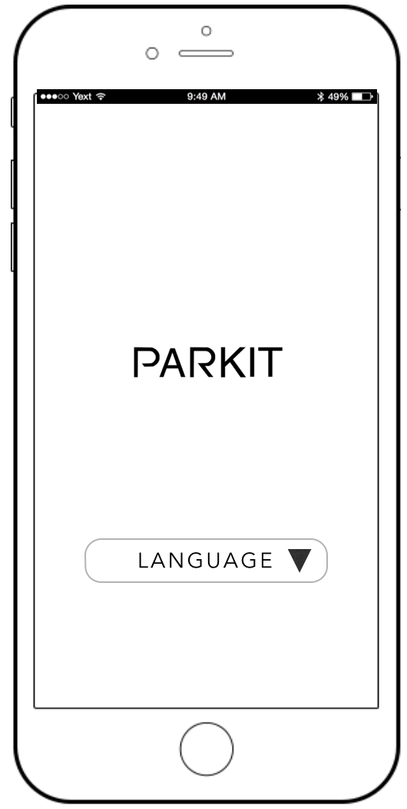
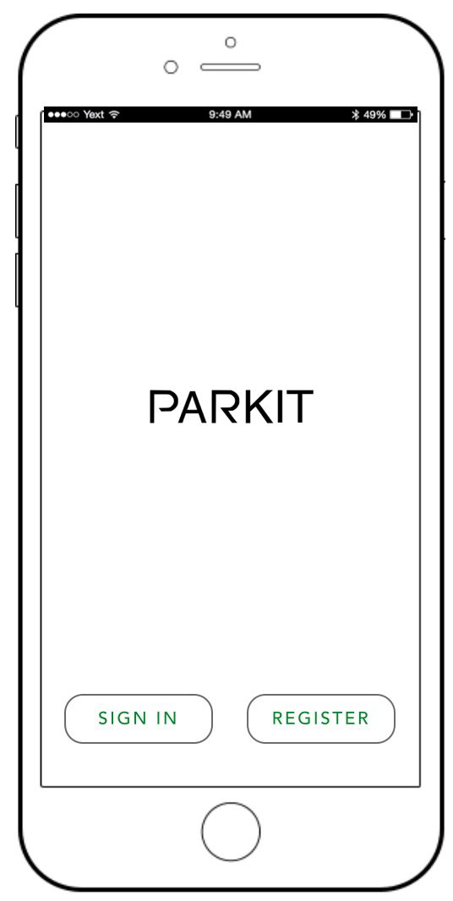
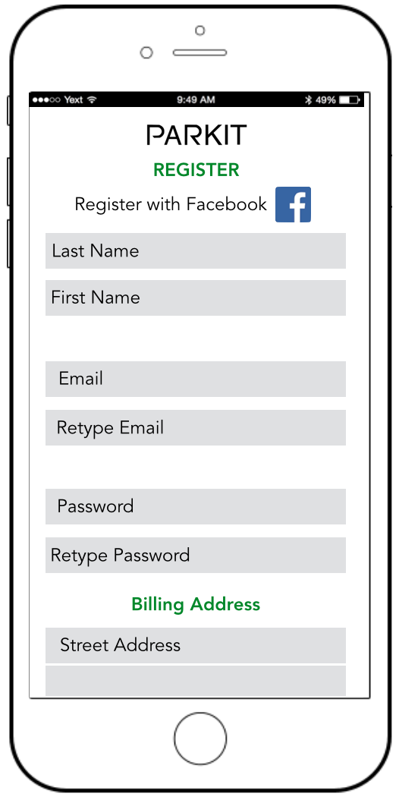
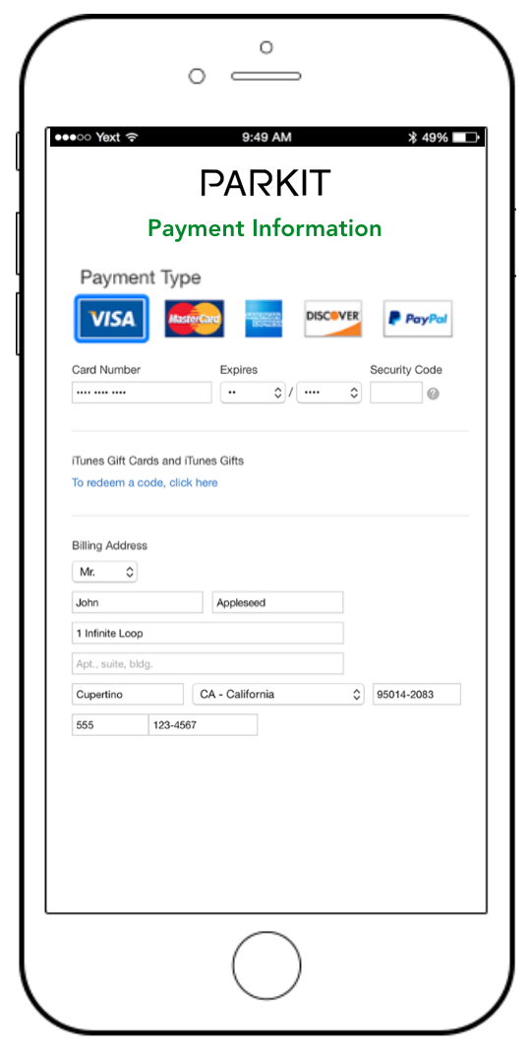
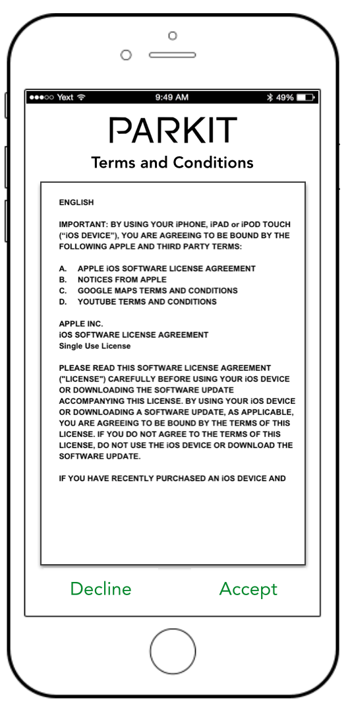
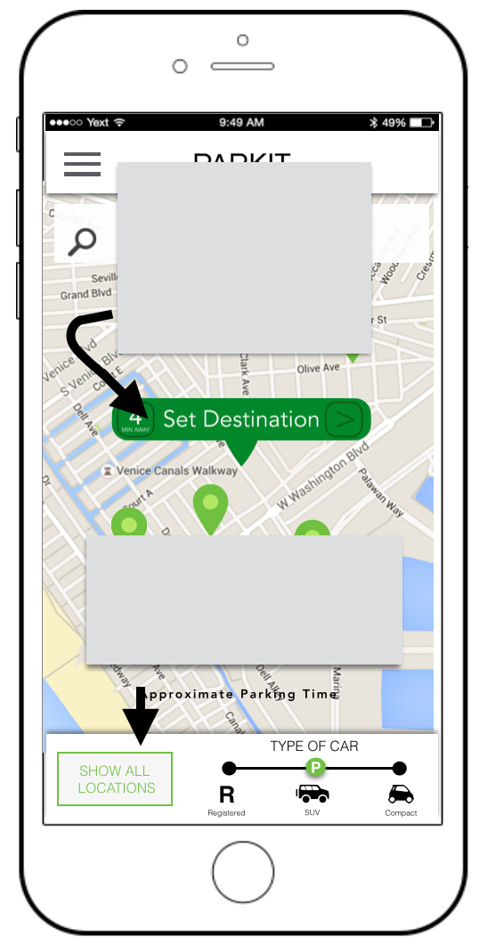
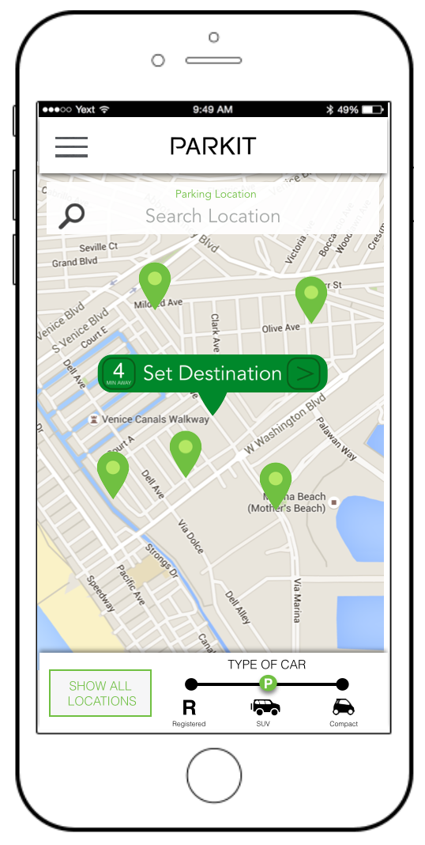
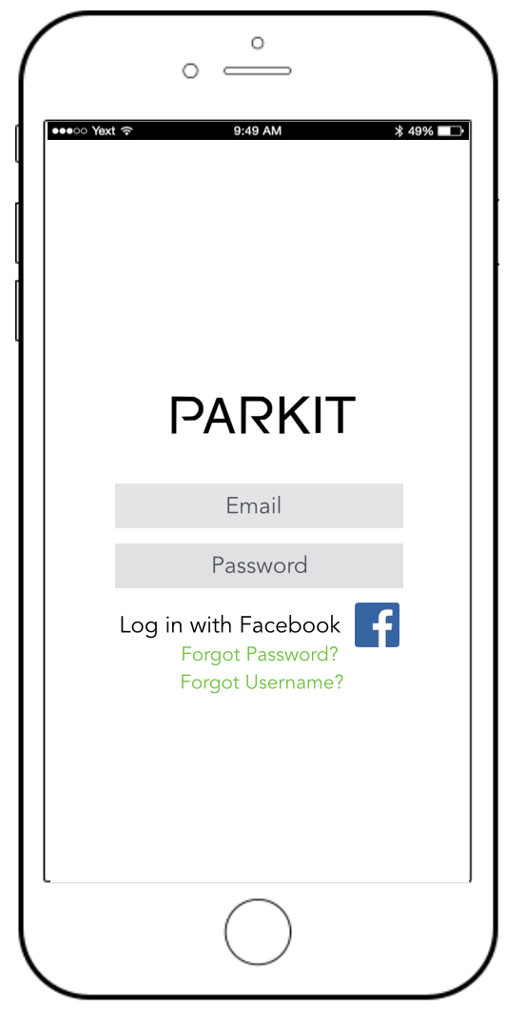
Register / First Time User
A
B
C
D
E
F
G
Sign In
B
H
G

Slide 5
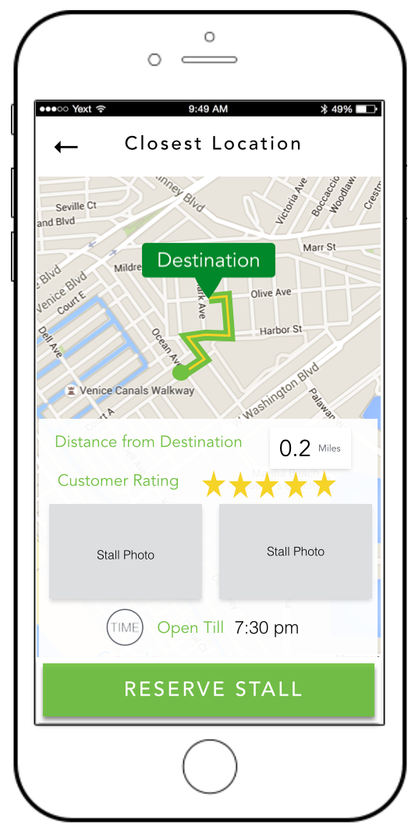
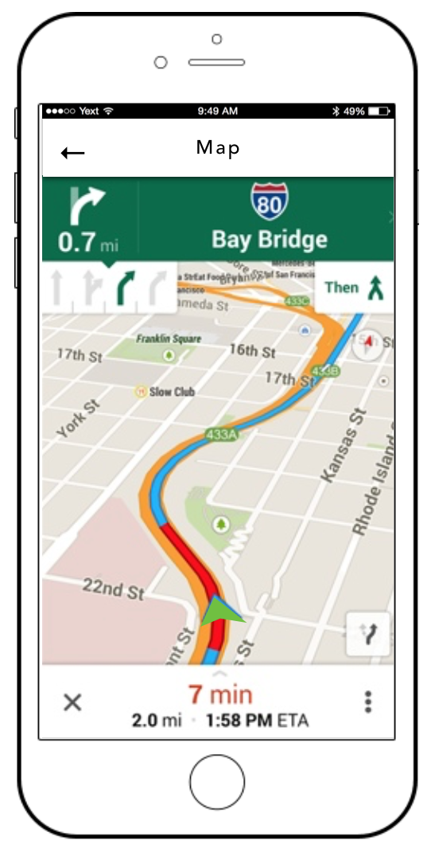
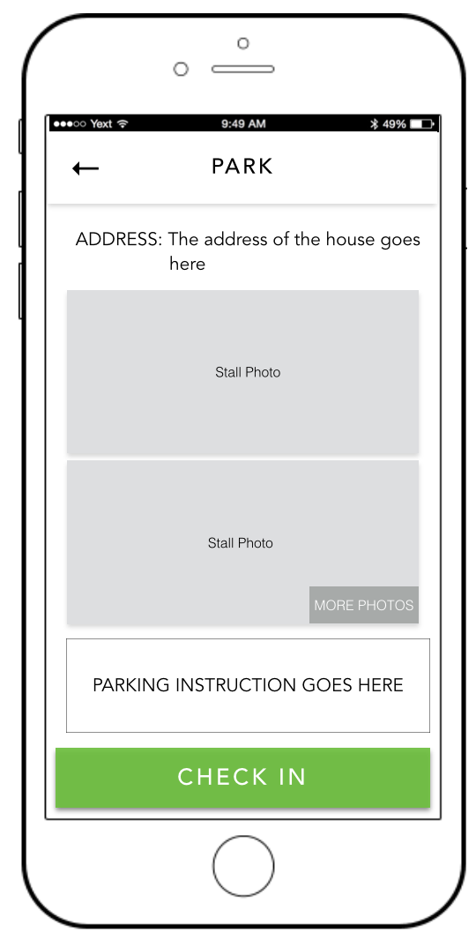
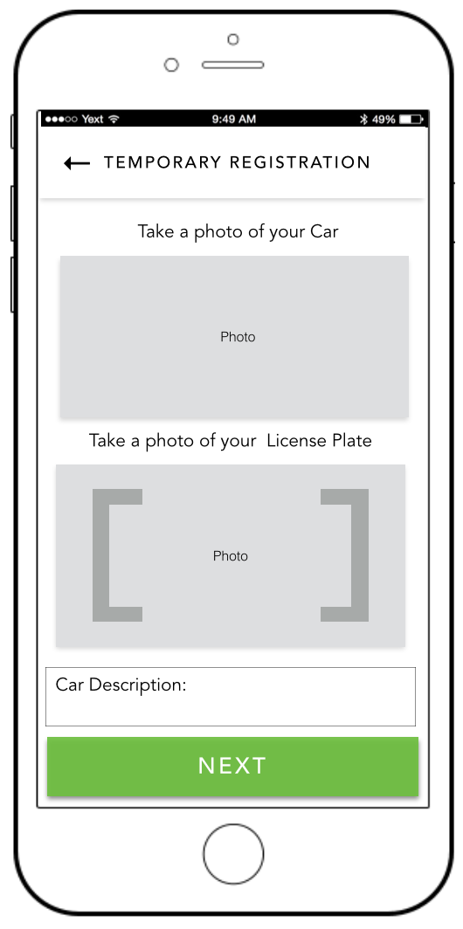
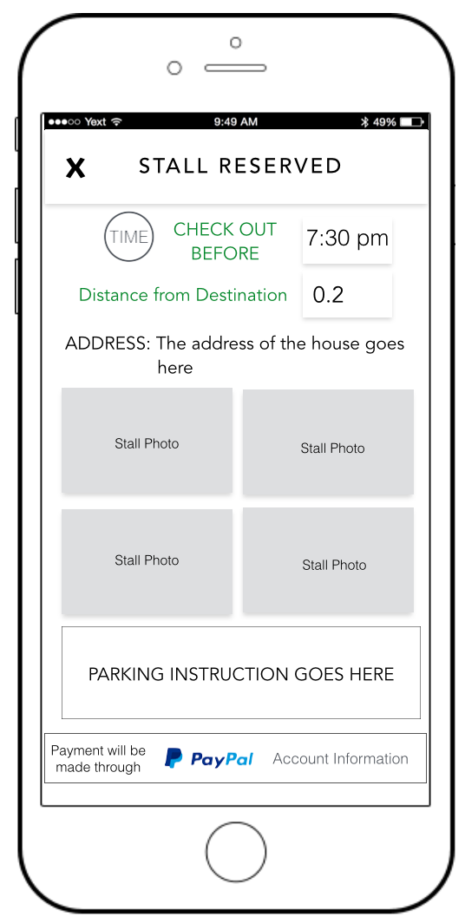
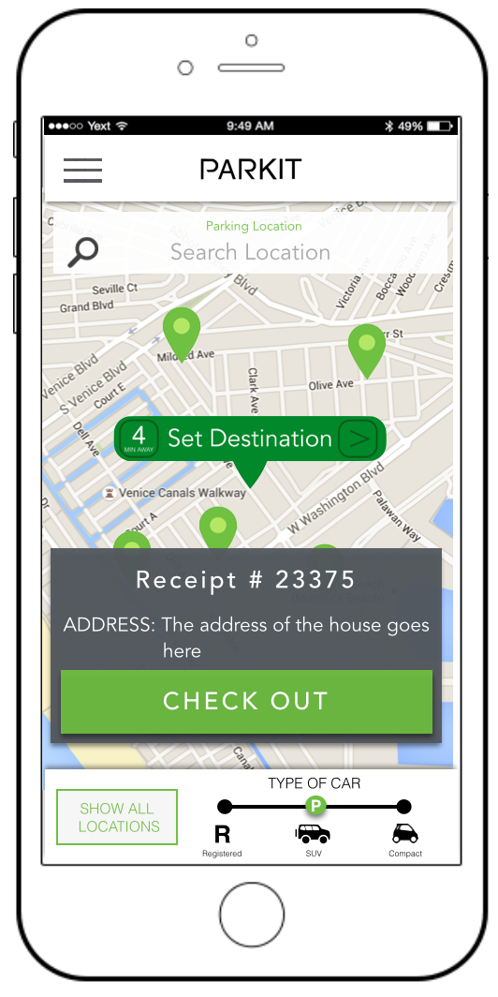
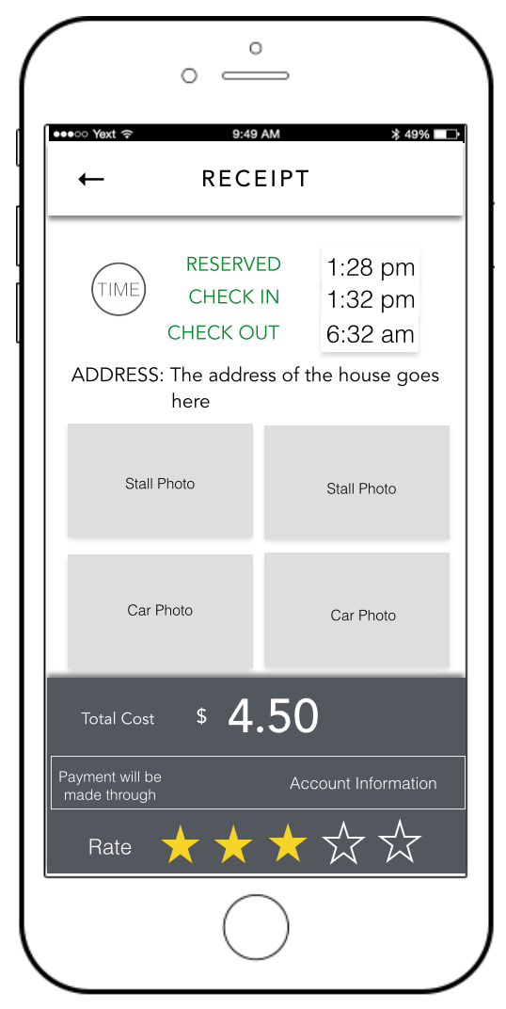
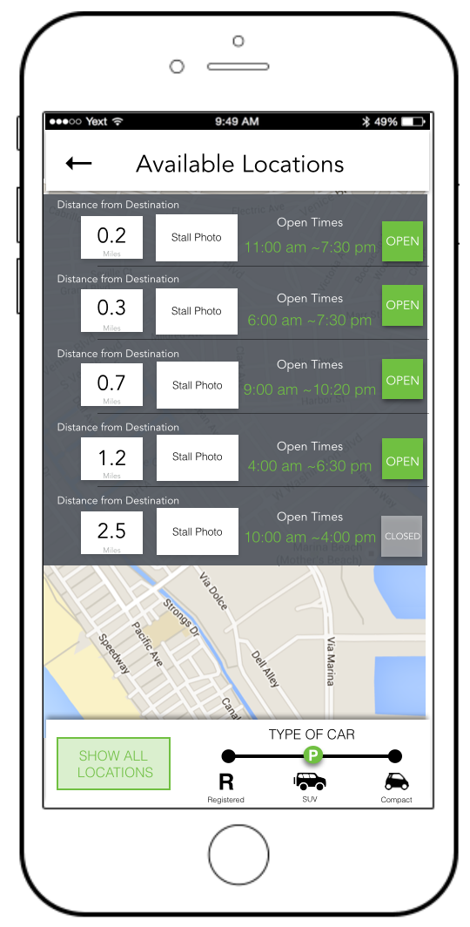
Setting Destination, Reserve, Check In
G
I
J
K
L
M
Check Out
Show All Locations
N
O
G
P

Slide 6
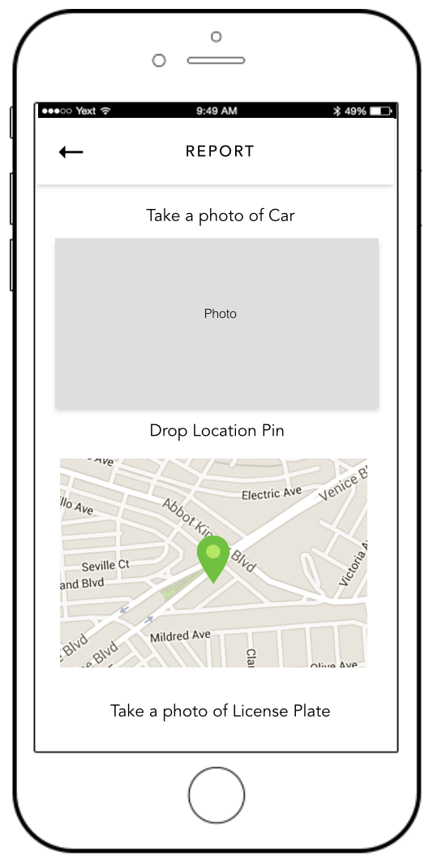
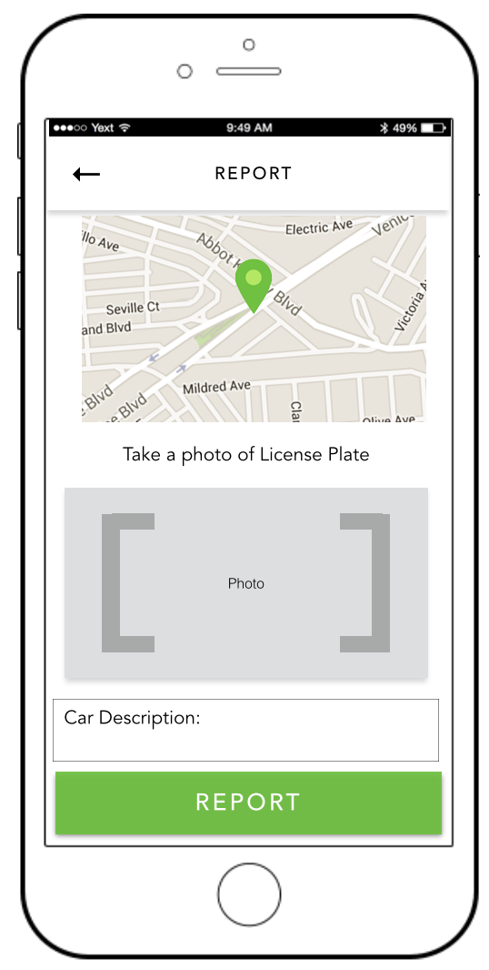
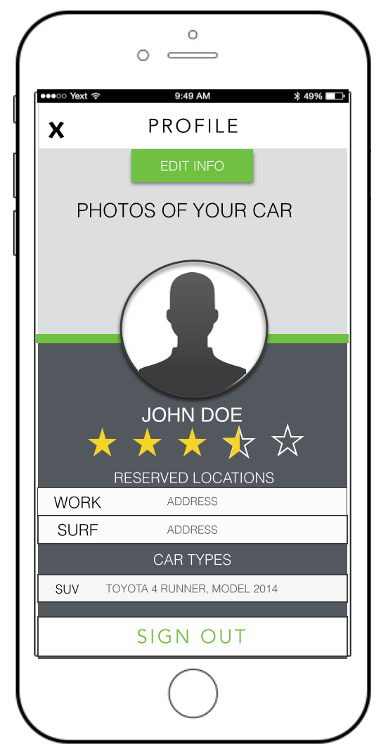
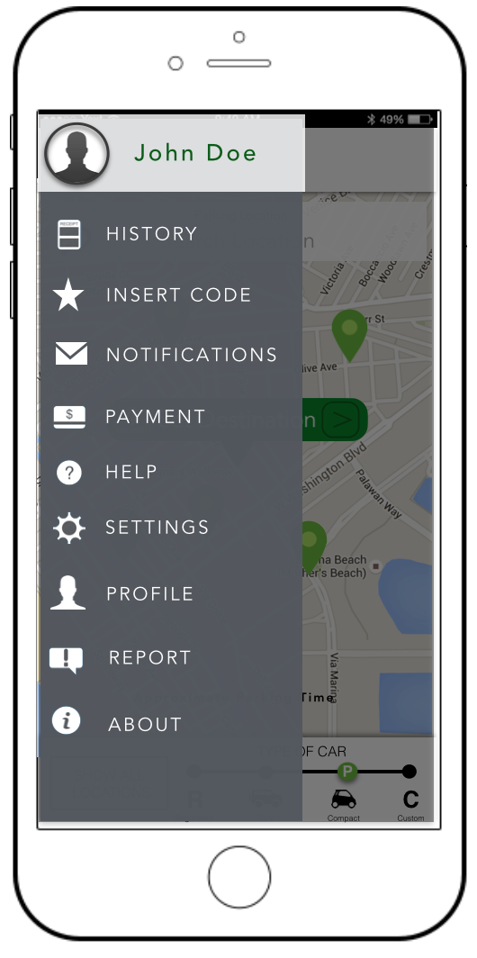
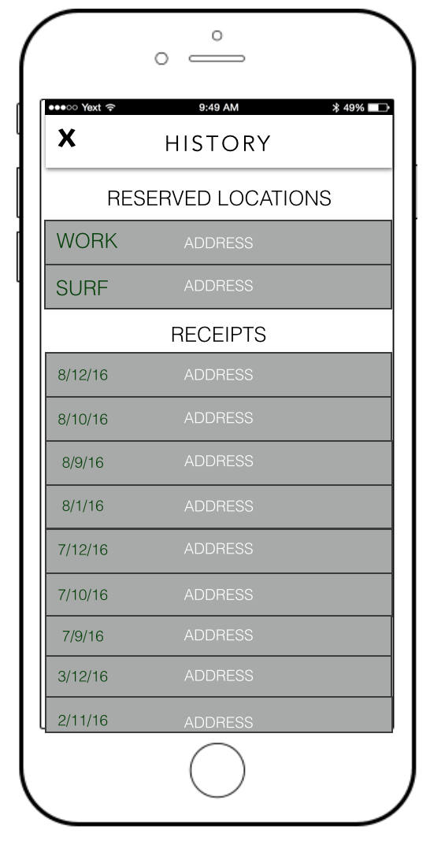
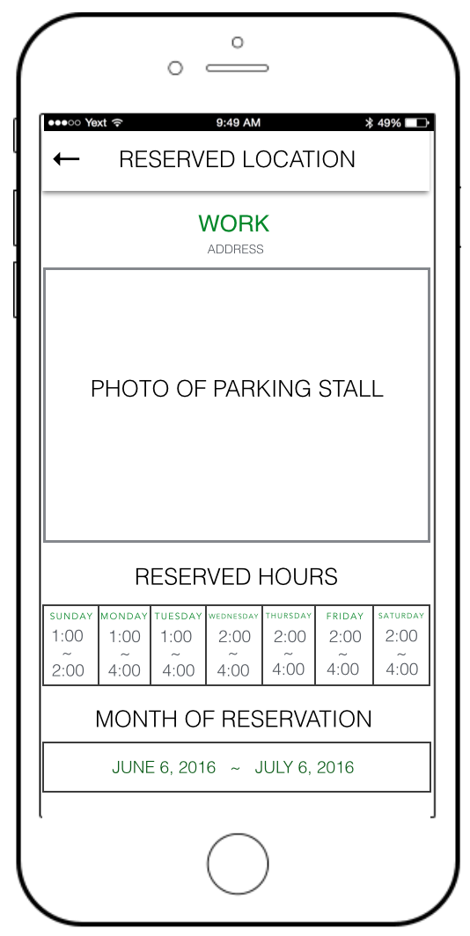
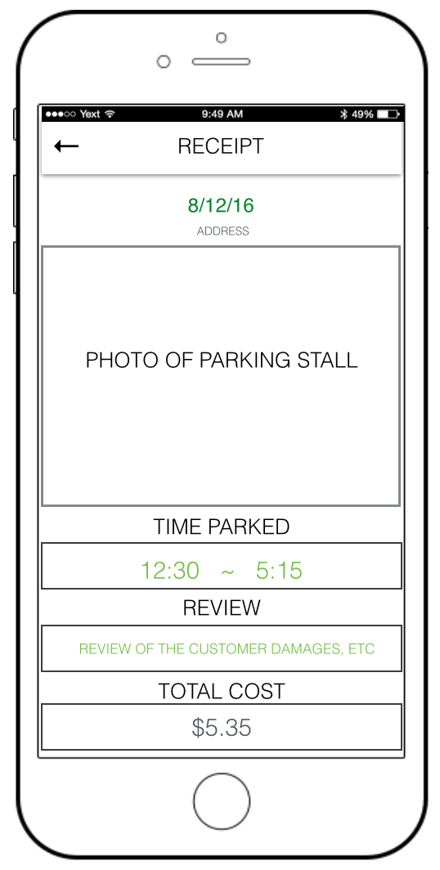
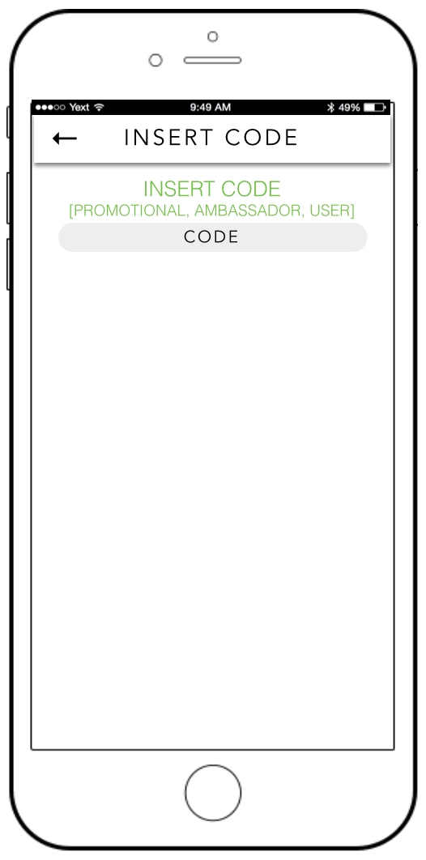
R
S
T
G
Q
U
V
W
x

Slide 7
A
B
C

Slide 8
D
E
F

Slide 9
G
H
I

Slide 10
J
K
L

Slide 11
M
N
O

Slide 12
P
Q
R

Slide 13
S
T
U

Slide 14
V
W
X

Slide 15
REGISTER
ARRIVED

Slide 16
Server Set-Up

Slide 17
Technologies Used
Xcode
NodeJS
Swift
Digital Ocean
Nginx
MySQL

Slide 18
Preliminary Development Schedule
January 14th - Registration and User Authentication should be implemented
January 20th - The parker should be able to reserve, check-in and check-out
January 27th - A payment system should be implemented
February 10th - User reporting is implemented and all high priority features are implemented
February 17th - Most graphical information such as maps and display rates are implemented

Slide 19
Preliminary Development Schedule (Continued)
March 11th - Admin GUI is implemented and Medium priority features should be implemented
April 3rd - Low priority features are implemented and the app is in Alpha
May 1st - Parkit is scheduled for Beta
June 5th – Parkit is scheduled for released

Slide 20
Conclusion
Parkit is an app that solves the problem of parking.
Parkit is planned to be released on iOS, Android and Web.
iOS Alpha is scheduled to be released April 3rd
iOS Beta is scheduled to be released May 1st
An official iOS release is scheduled to be released June 5th

Slide 21
Questions?

Slide 22
Thank You!

